Slide 1
AI is Coming: Getting Started With Microsoft Cognitive Services

Slide 2
Who am I?
Jeorry Balasabas
Datarambler.com
jeorry@gmail.com
@jeorryb
Github.com/jeorryb

Slide 3





Thank Our Sponsors
Platinum Sponsors

Slide 4



Thank Our Sponsors
Platinum Sponsors

Slide 5



Thank Our Sponsors
Gold Sponsors

Slide 6
Agenda
History
Machine Learning/Deep Learning
Microsoft Cognitive Services
Examples
Q & A

Slide 7



Slide 8
Notes:
What is machine learning?
If you’ve ever fit a line to data then you’ve performed machine learning
Specify a model, give that model some data then that model lets us predict what other data might look like

Slide 9
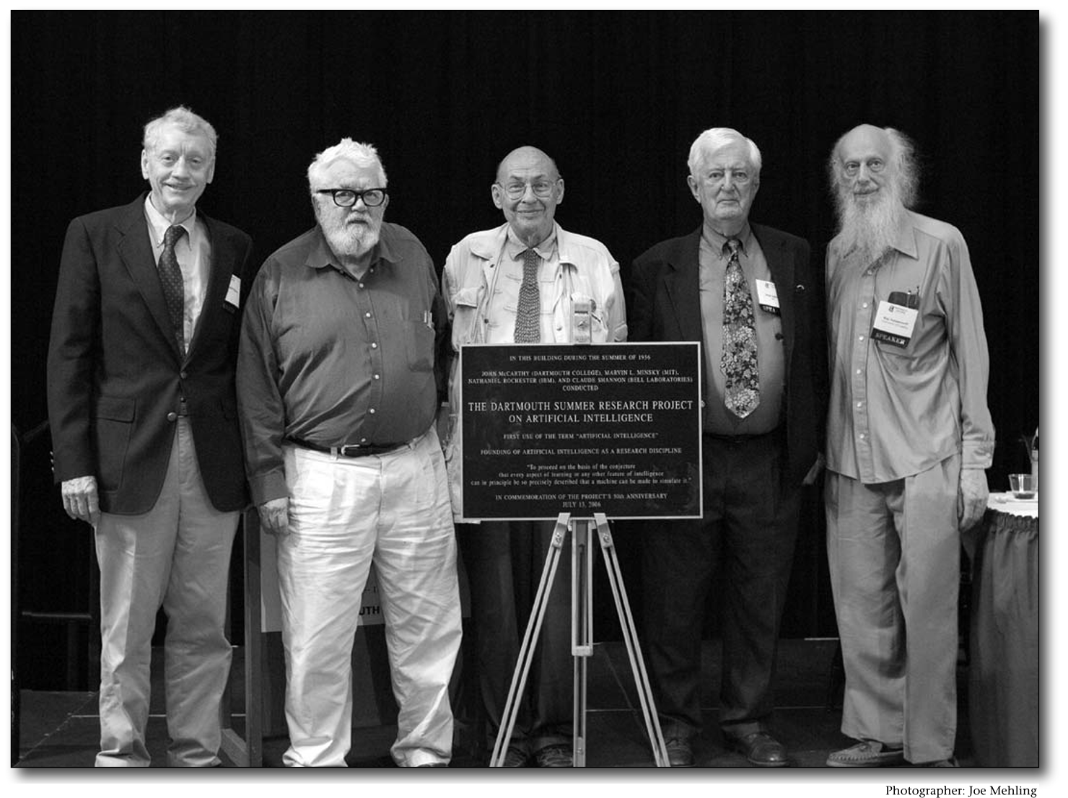
Notes:
Dartmouth summer research project 1956
John Mccarthy, Marvin Minsky
Program computers to behave like humans

Slide 10
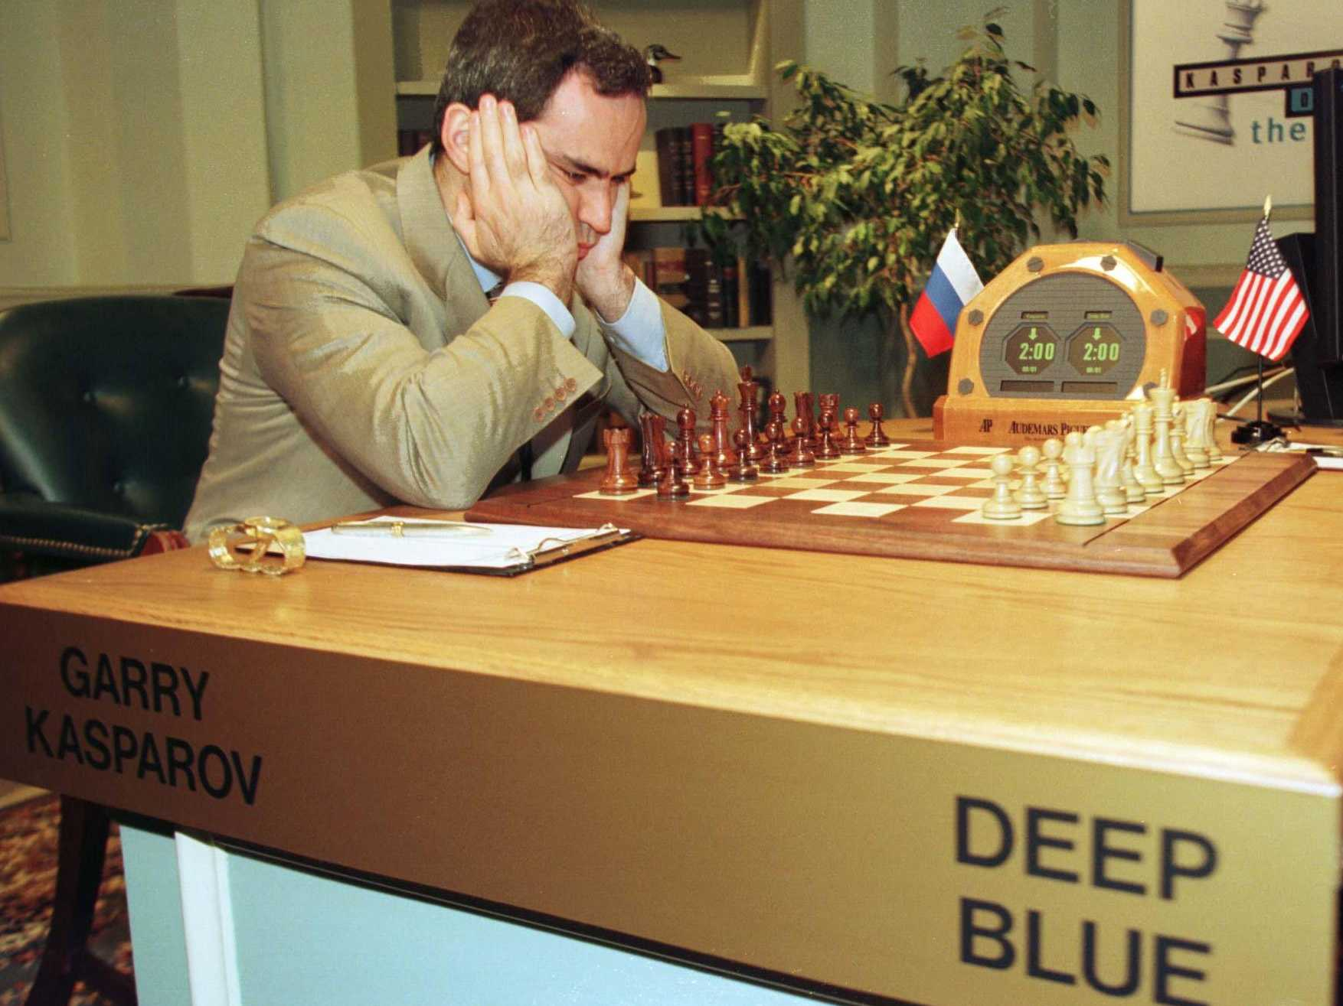
Reasoning
Notes:
Reasoning
Presented with a task and you reason your way to a solution
Chess, deep blue reasoning system

Slide 11
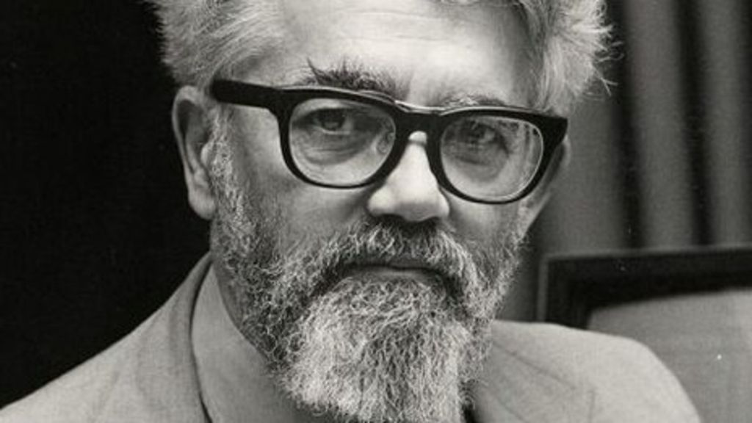
Knowledge Representation
Notes:
Teach computers about things in the world
John Mccarthy – inventor of LISP

Slide 12
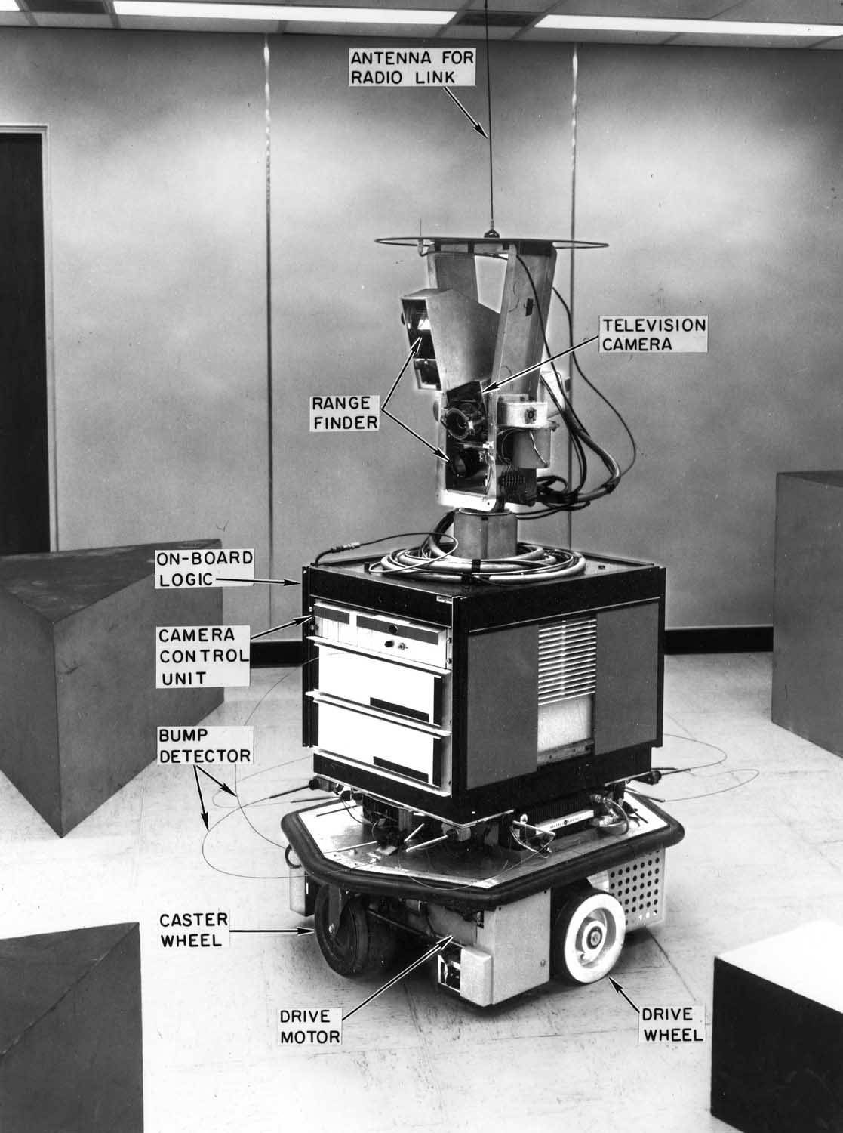
Planning/Navigation
Notes:
How to get from point A to point B
How to move through space
Shakey the robot developed at SRI, 1st general purpose mobile robot to reason about it’s own actions

Slide 13
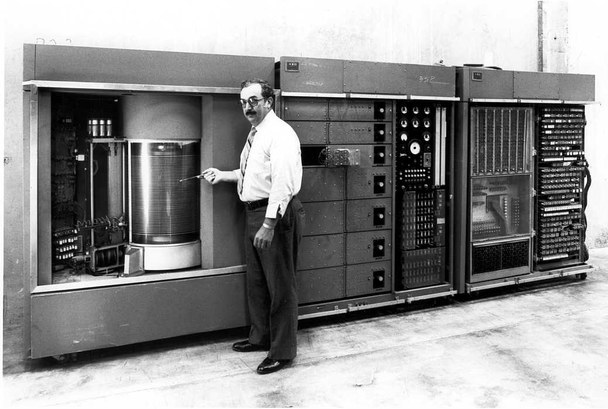
Natural Language Processing
Notes:
How to speak a language
How to understand context
Ibm mainframe, translate english to russian and back

Slide 14
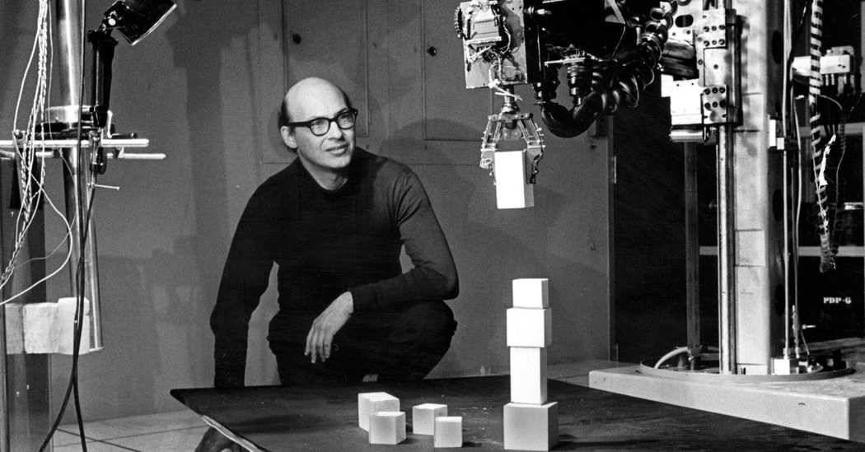
Perception
Notes:
Teach computers how to touch, feel, smell, and see
Marvin Minsky
See if we can feed video input to computers and teach them to move small block onto big block

Slide 15
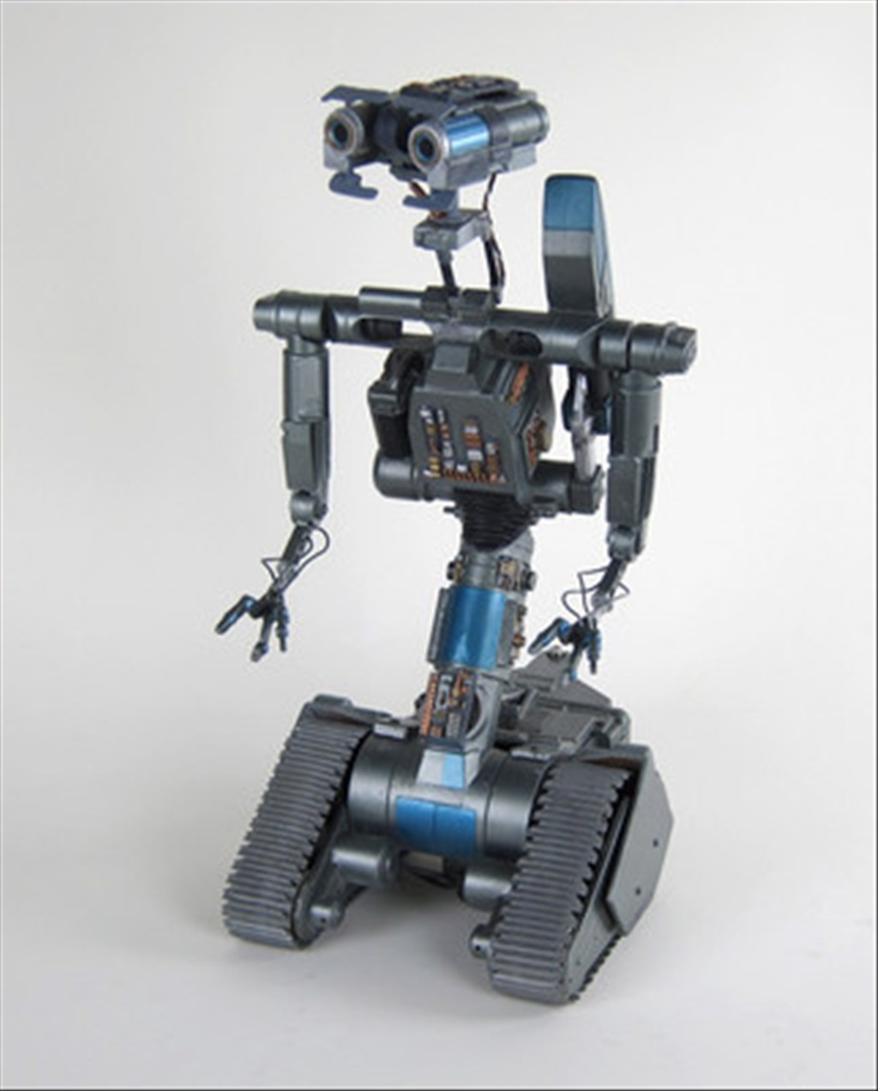
Generalized Intelligence
Notes:
If we could teach computers a bunch of these small tasks, they would form generalized intelligence
It would have creativity, humor, fully autonomous thinking robot
Might be indistinguashable from humans

Slide 16

AI Winter
Notes:
What happened was a series of boom and bust cycles
A lot of research funding and startups, then they would bust

Slide 17
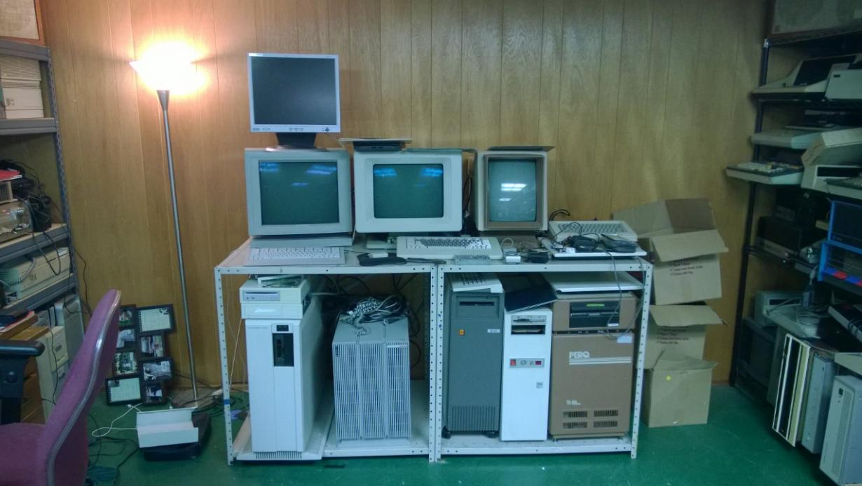
Expert Systems
Notes:
Symbolic LISP machine – 1980’s era
Take something wildly complicated, sophisticated and program expert systems
Find expert, interview, codify knowledge into expert system
Maybe the next expert system would be easier to build
Building 1 expert system didn’t give you a leg up on building the next one

Slide 18
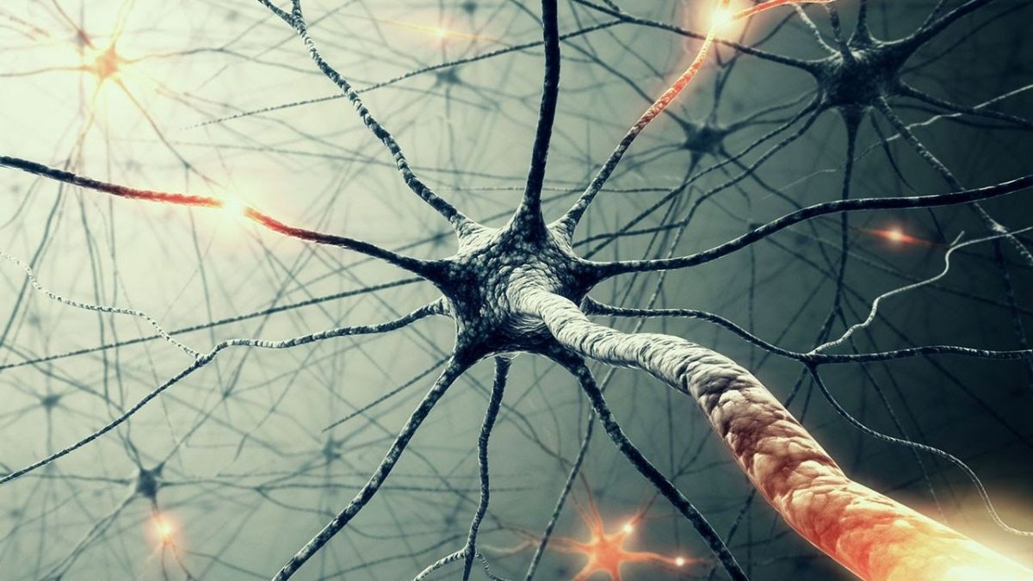
Deep Learning
Notes:
Breakthrough is deep learning
Class of machine learning algorithms
Feed data structures modeled on human brain a bunch of data
Algo’s help computer learn based on that data
Originated in 1940’s, neural network
Yann lecun – facebook AI lab – recognize handwriting zip codes
Jeff hinton – google AI – deep belief networks – research led to speech to text algo’s in android

Slide 19
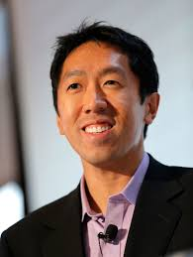

2012: Andrew Ng & Google Brain
Notes:
Stanford reasearcher
10m videos + 1000 servers and 16000 cores
Neural net = cats
16% of 20000 object database, 1000’s got recognized
No expert said here is how you find a cat
Fed a bunch of data and it found how to categorize a bunch of objecs on it’s own

Slide 20

Notes:
People excited because of scale
Deep learning research since then and increased funding and start up money
Lot of enthusiasm around deep learning

Slide 21

Bring it back

Slide 22
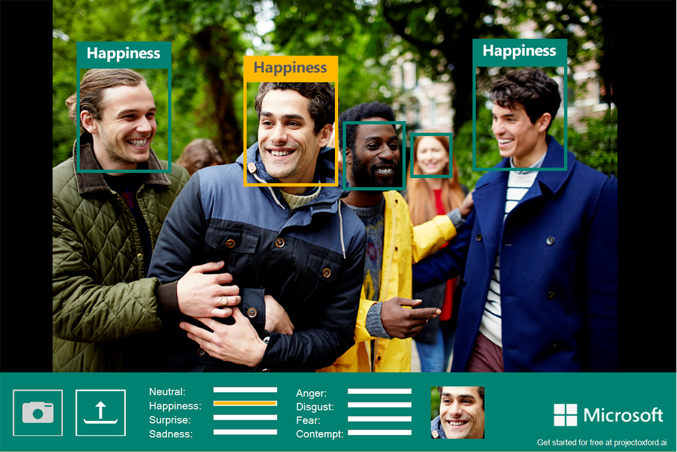
Microsoft Cognitive Services

Slide 23
Emotion API
Accessible via REST
Upload image file (photo/video) from disk or URL
Returns confidence across a set of of emotions
Happiness, sadness, surprise, anger, fear, contempt, disgust, neutral

Slide 24
Register for API Key

Slide 25
API Trial Limits

Slide 26
Emotion API
import requests
import json
_url ='https://westus.api…/recognizeinvideo’
_key = 'xxxxxxxxxxxx’
_maxNumRetries = 10

Slide 27
Emotion API
headerspost = {'Ocp-Apim-Subsc…-Key': _key,
'Content-Type': 'application/octet-stream'}
paramspost = {'outputStyle': 'perFrame'}
datapost = open('/…/gots7.mp4','rb').read()
responsepost = requests.post(_url, data=datapost,
params=paramspost,
headers=headerspost)

Slide 28
Emotion API
print responsepost.status_code
202
videoIDLocation = responsePost.headers['Operation-Location']
headersget = {'Ocp-Apim-Subscription-Key': _key}
getresponse = requests.get(videoIDLocation, headers=headersget)
print getresponse.status_code
200

Slide 29
Emotion API
Result = json.loads…(getresponse.text)
['processingResult'])
rawData = json.loads(getresponse.text)
print rawData

Slide 30
Emotion API
{u'status': u'Succeeded', u'progress': 100.0, u'createdDateTime': u'2017-01-20T16:14:59.4549364Z', u'processingResult': …
,"events":[[{"id":0,"x":0.540625,"y":-0.0388889,"width":0.259375,"height":0.461111,"scores":{"neutral":0.50085,"happiness":0.000270213,"surprise":0.000819597,"sadness":0.490348,"anger":0.000952272,"disgust":0.00246058,"fear":0.00130964,"contempt":0.00298951}}]…

Slide 31
…after some Data Munging

Slide 32
API Emotion

Slide 33
Sentiment API
_senturl = 'https://…analytics/v2.0/sentiment’
_sentkey = ’xxxxxxxxxxxxxx'
sentheaders = {'Ocp-Apim-…-Key': _sentkey, 'Content-Type': 'application/json',
'Accept': 'application/json'}

Slide 34
Sentiment API
sentdata = {'documents':
[{'language': 'en',
'id': '1',
'text': ‘OK, so "Gigli" is not the worst film in years. That dubious title still goes to "Swept Away," or maybe "Freddy Got Fingered." But "Gigli" is still a huge waste of celluloid.’}]}

Slide 35
Sentiment API
sentpost = requests.post(_senturl, data=json.dumps(sentdata),
headers=sentheaders)
print sentpost.json()
{u'documents':
[{u'score': 0.3163544,
u'id': u'1'}],
u'errors': []}

Slide 36
Takeaways
Helps to use a library that make REST calls easier
Documentation on Cognitive Services API is lacking
A little data munging is required to present in human readable format

Slide 37
Questions?

Slide 38

That’s what I do…

Slide 39

Continue the conversation…
See website for more info and directions
https://cloudsaturdayatlanta.com/

